Slide 1
ELO Merchant Category Recommendation
Data Science Intensive Capstone Project, Oct 1st 2018 Cohort
Bibek Mishra

Slide 2
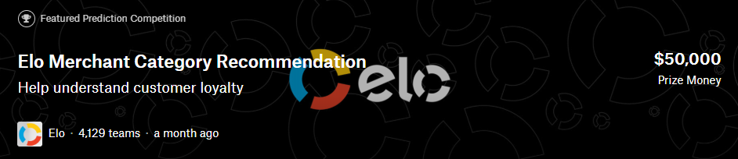



Introduction
About ELO:
ELO is a payment brand in Brazil
Goal: Increase the transactions volume through ELO brand.
ELO wants to send promotions to customers provided by merchants in its network.
Who should ELO target these promotions ?
Targeted Promotion => Lower Promotion Expenses
Can ELO quantify the Customer Loyalty
Who are promotion worthy customers? Any specific characteristics?

Slide 3
Objective
Project tries to answer following questions
Did the customers enjoy their experience ? Did the merchants see repeat business ?
What level of personalization can be used for prediction of promotion worthiness.
Can we build a predictive model from the data of cardmembers, transactions and merchants to accurately predict the target score of a customer.
What are the typical characteristics of promotion-worthy customers

Slide 4





Who might care?
The insights in the project can be valuable to any business with following goals
How to build a cost-effective marketing strategy through targeted promotions.
f
Promotions to all customers (Expensive) vs Targeted Promotions based on customer loyalty (Less Expensive)
Understand customer loyalty.
Payment Brands
Retail, eCommerce

Slide 5
Datasets
Training/Test Dataset
Card Identifier, Joining Month, Individual Features, Target
Target: Loyalty Score
Historical Transactions/ New Merchant Transactions
New Merchant Transactions: 2 months worth of transactions at Merchant IDs not visited in Historical Transactions.
Transactions of Card Members: Purchase Amount, Purchase Date, Installment, Location (State, City)
Merchant Identifier, Card Identifier
Historical Transactions: 3 months of historical Transactions
Merchants
Merchant ID
Merchant specific characteristics

Slide 6
Exploratory Data Analysis Data Wrangling
Training Dataset
Merchants
Historical Transactions/
New Merchant Transaction

Slide 7
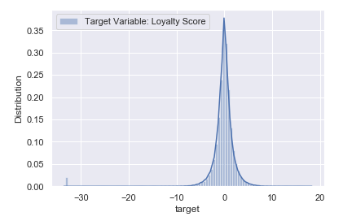
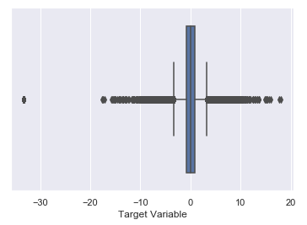
Training Dataset
Data Wrangling
New Field: Elapsed Active Days: Reference Date – First Active Month
One Hot Vectorization: feature_1, feature_2 and feature_3
Exploratory Data Analysis
Insights
Target variable is
Normally distributed with a few extreme outliers (< 30)

Slide 8
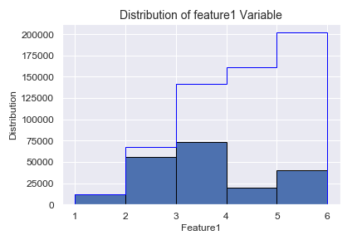
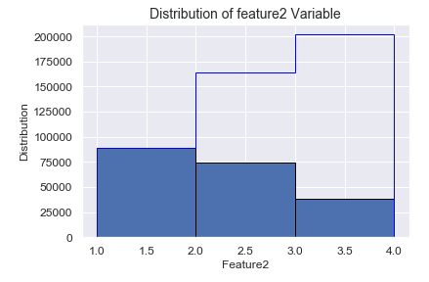
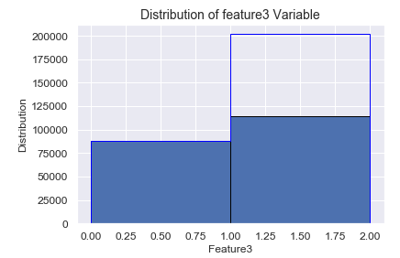
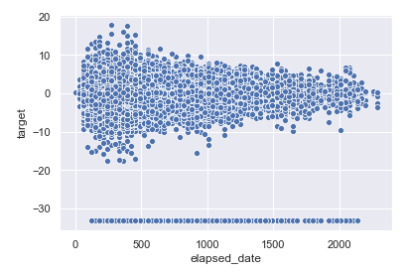
Training Dataset
Relation of variables with Target
Insights
Frequent Values in feature_1: 2, 3
Target close to Zero as elapsed days increase.

Slide 9
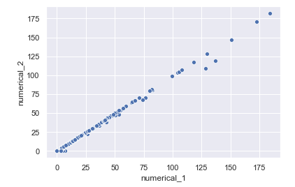
Merchants
Data Wrangling
One Hot Vectorization: most recent sales range, most recent purchase range
Boolean to Numeric Transformation (Y/N -> 1/0): category_1 and category_4
Null Handling: Nulls in category_2 replaced with median value
Exploratory Data Analysis
Insights
Numerical_1 and Numerical_2 highly correlated.
Numerical_2 variable will be dropped to avoid multi-collinearity

Slide 10
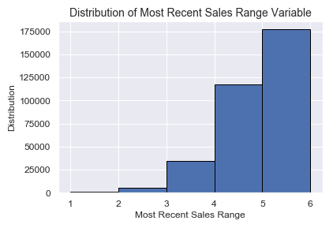
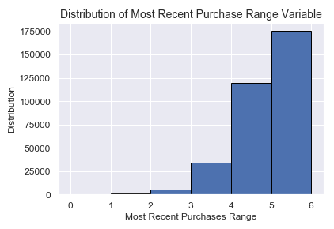
Merchants
Exploratory Data Analysis
Insights
Highest number of merchants had Most Recent Sales Range or Most Recent Purchase Range as 5.

Slide 11
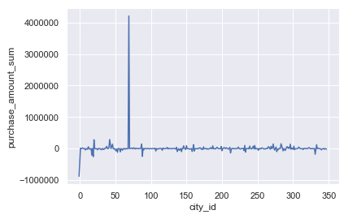
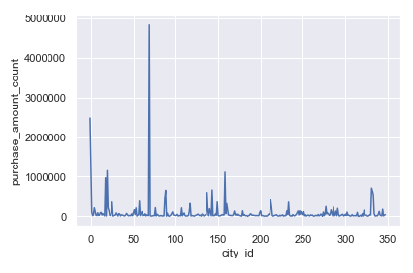
Historical Transactions/New Merchant Transactions
Data Wrangling
One Hot Vectorization: category_2 and category_3
Boolean to Numeric Transformation (Y/N -> 1/0): authorized_flag and category_1
New Column: Purchase Elapsed Days = Reference Date – Purchase Date
Exploratory Data Analysis
Add Indicators for
cities -1, 69 and 333.
Insights
Absolute Purchase Amount Sum high for cities 69 and -1. Similarly, Purchase Amount Count high for cities -1, 69 and 333.

Slide 12
Datasets Combination Strategy
Datasets | Granularity
Training,Test | card_id
Historical Transactions, New Merchant Transactions | card_id, transaction timestamp
Merchants | merchant_id
I. Aggregation
Historical Transactions LJ Merchants ON Merchant ID -> HIST_TRAN_MER
Aggregate HIST_TRAN_MER at Card ID Granularity -> HIST_TRAN_MER _AGG
TRAINING LJ HIST_TRAN_MER _AGG ON Card ID -> TRAIN_HIST_TRAN_AGG
New Merchant Transactions -> TRAIN_NEW_MER_TRAN_AGG (Similar transformations)
TRAINING LJ TRAIN_HIST_TRAN_AGG LJ TRAIN_NEW_MER_TRAN_AGG -> TRAIN
TEST LJ TEST_HIST_TRAN_AGG LJ TEST_NEW_MER_TRAN_AGG -> TEST (Similar Transformations)
* LJ : Left Join

Slide 13
Datasets Combination Strategy
II. Decomposition
The Transaction Datasets are very large
Historical Transactions: 29 million transactions
New Merchant Transactions: 1.9 million transactions
Divide and Conquer
New column added to training dataset: LOW, MED, HIGH based on Target score
Each part was joined with Historical Transactions and New Merchant Transactions respectively and aggregated separately. Finally, all parts concatenated to form fi nal training and test datasets.

Slide 14
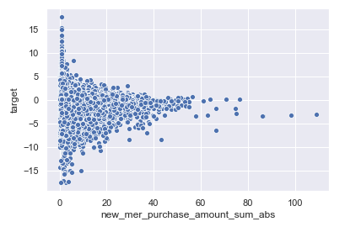
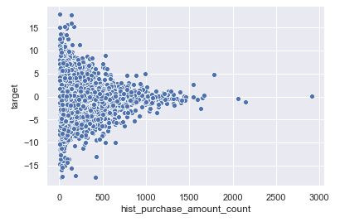
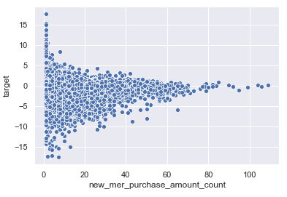
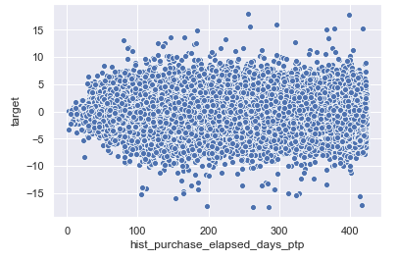
Historical Transactions/New Merchant Transactions
Relation of Aggregated Variables with Target
Insights
The target score of customers with high total purchase amount or high total purchase count leaned towards zero.
Customers with high purchase date range had a score away from zero.

Slide 15
Insights from Exploratory Data Analysis
Did the customers enjoy their experience? Did the merchants see repeat business?
Yes, Most customers revisited the merchants they already went to
What level of personalization can be used for predictive modeling
Feature variables of cardholders (feature_1, feature_2, feature_3), Length of Membership
Features associated with cardmembers’ purchase transactions (installments, other features, purchase amount, elapsed days since purchase days)
Characteristics of merchants at which the cardmembers shop.
Historical Transactions/
New Merchant Transaction
Merchants
Training Dataset

Slide 16
Insights from Exploratory Data Analysis
Few Characteristics associated with promotion worthy customers
High Unique Merchant ID Count, High Unique Merchant Group ID Count
High Purchase Amount Sum
Higher Elapsed Days Range
High Sum of Numerical_1 Quantity
Lower Unique Cities of Transaction
Model Building
Discover the most important features influencing target variable.
Predict the target variable of customers from their data
Historical Transactions/
New Merchant Transaction
Merchants
Training Dataset

Slide 17
Predictive Modeling

Slide 18
Modeling Overview
Type: Supervised learning
Regression: Light GBM and Ridge Regression
Feature values have difference range
Feature Scaling Required
Tools: Python’s Scikit Learn and LightGBM

Slide 19
Model I: Light GBM Full Model
Why Light GBM ?
Ensemble Algorithms have better performance than individual decision trees.
As Light GBM is base on decision trees, the feature importance can be easily explained.
Faster training time (vs. Extreme Boosting Algorithm)
Challenge
Hyper-parameter tuning required.
Modeling Approach
Feature scaling on training and test dataset.
Optimal hyper-parameters found through CVGridSearch.
Optimal hyper-parameters used for building model.
Best model (with lowest RMSE) found through cross validation.
CVGridSearch ensures that the best hyper parameters found through cross-validation. Hence, the parameters do not overfit on training data.
Optimal Hyper Parameters
Learning Rate: 0.01
Boosting Type: gbdt
Objective: Regression
Metric: l2_root
sub_feature: 0.5
num_leaves: 30
min_data: 50
max_depth: 7

Slide 20
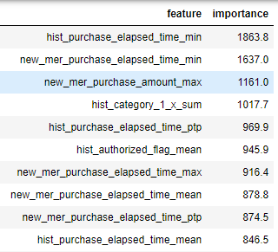
Model I: Light GBM Full Model
Model Performance
Best Model RMSE: 3.5762
Feature Importance (Top 10 Features)
Building a Reduced Model can help uncover the influence of top predictors after eliminating noise from other predictors
This model built over 160 features.
Subsequent model will be built over top 25% features (40 features)

Slide 21
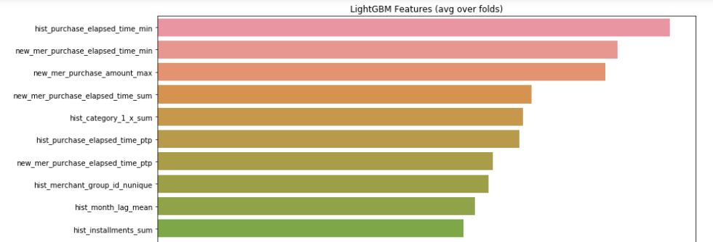
Model II: Light GBM Reduced Model
Hyper-parameters tuned again and Light GBM model built from 40 features.
Model Validation
Best Model RMSE: 3.5898
Feature Importance (Top 10 Features)
Best Predictors
Recency of Transactions
Purchase Amount
Past Purchases
Category_1 in Historical Transactions
Date Range of Purchases
Number of Unique Merchants shopped from
High month installments.

Slide 22
Model III: Ridge Regression Model
Why Ridge Regression?
The algorithm puts a penalty on features with high values.
Helps stabilize the model as large values in features can shift RMSE greatly.
Challenge
Hyper-parameter tuning required.
Modeling Approach
Optimal hyper-parameter alpha found through CVGridSearch.
Optimal hyper-parameter used for building model.
Best model (with lowest RMSE) found through cross validation.
Model Validation
RMSE of Best Model: 3.717

Slide 23
Model Comparison
Model | Training Dataset (CV Score) | Test Dataset (Submitted)
LightGBM Full | 3.5762 | 3.71266
LightGBM Reduced | 3.5898 | 3.71770
Ridge Regression |  | 3.717
Analysis
Based on Model RMSE, the LightGBM Full model had the best performance.
The RMSE score of model on test dataset was higher than the RMSE score of model on training data (Cross Validation).

Slide 24
Recommendations for ELO
Targeted Promotions
Predict/Derive target score of customers from the model. Target promotions to customers with high target score.
Characteristics of Customers with High Target Score
Recency of Transactions: Customers who purchased in recent past.
High Aggregated Purchase Amount: Customers with high aggregated purchase amount
High number of old transactions: Customers with a high number of old transactions
Sum of Category_1: Customers with a high aggregate sum of category_1.
Long Data Range of Purchases: Customers with a longer date range of purchases.
High number of Unique Merchants: Customers with transactions that involved a high number of unique merchants.
High Duration Installments: Customers who purchase items with high duration installments.
Transaction Characteristics: Customers with high transactions associated with category_1(value 1) and category_3 (value B).

Slide 25
Future Work
Implement a neural based predictor on the ELO datasets.
Build an ensemble of models that may have better predictability over individual models.
Use additional geo based insights from the data.
For example: Leveraging clustering to group merchants based on their geographies (state or city)

Slide 26
Reference & Disclaimer
Reference
I am thankful to the participants of ELO Merchant Category Recommendation Kaggle
contest who shared public kernels and their invaluable insights on the Kaggle Challenge.
Disclaimer
All product names, logos, and brands are property of their respective owners. All company, product and service names used in this website are for identification purposes only. Use of these names, logos, and brands does not imply endorsement.

Slide 27
Thank You
Bibek Mishra
Email: bibekmishra@aggienetwork.com
Github: www.github.com/bibekm

